Slide 1

EmotiSense
Atmakuri Krishnasai Bharadwaj
Mohammadreza Akbari Lor
Mohitha Dayana
Hema Nagini Matta
A Multi-Modal Emotion Detection Framework

Slide 2

Selling idea
EmotiSense can be used is in online education. EmotiSense can help teachers monitor and improve student engagement, motivation, and learning outcomes by providing real-time feedback and personalized interventions based on their emotional states. For example, EmotiSense can analyze the text, speech, and face cues of the students during a live or recorded lecture, and identify their emotions, such as boredom, confusion, interest, or frustration. Based on this information, EmotiSense can suggest the teacher to adjust the pace, difficulty, or style of the lecture, or to provide more examples, quizzes, or feedback to the students. EmotiSense can also help students develop their emotional intelligence and self-regulation skills by reflecting on their own emotions and learning strategies, and by offering them emotional support and guidance.

Slide 3


Intro
Emotions are essential to human nature. We use different ways to show our feelings, such as our faces, voices, words, or pictures.
Machines can help us understand emotions.
They can also mimic emotions to interact better with us.

Slide 4
How many facets of human emotions are essential for authentic communication with the rest of the world?

Slide 5
Just one! Your own.
With a little help from our EmotiSense Product

Slide 6
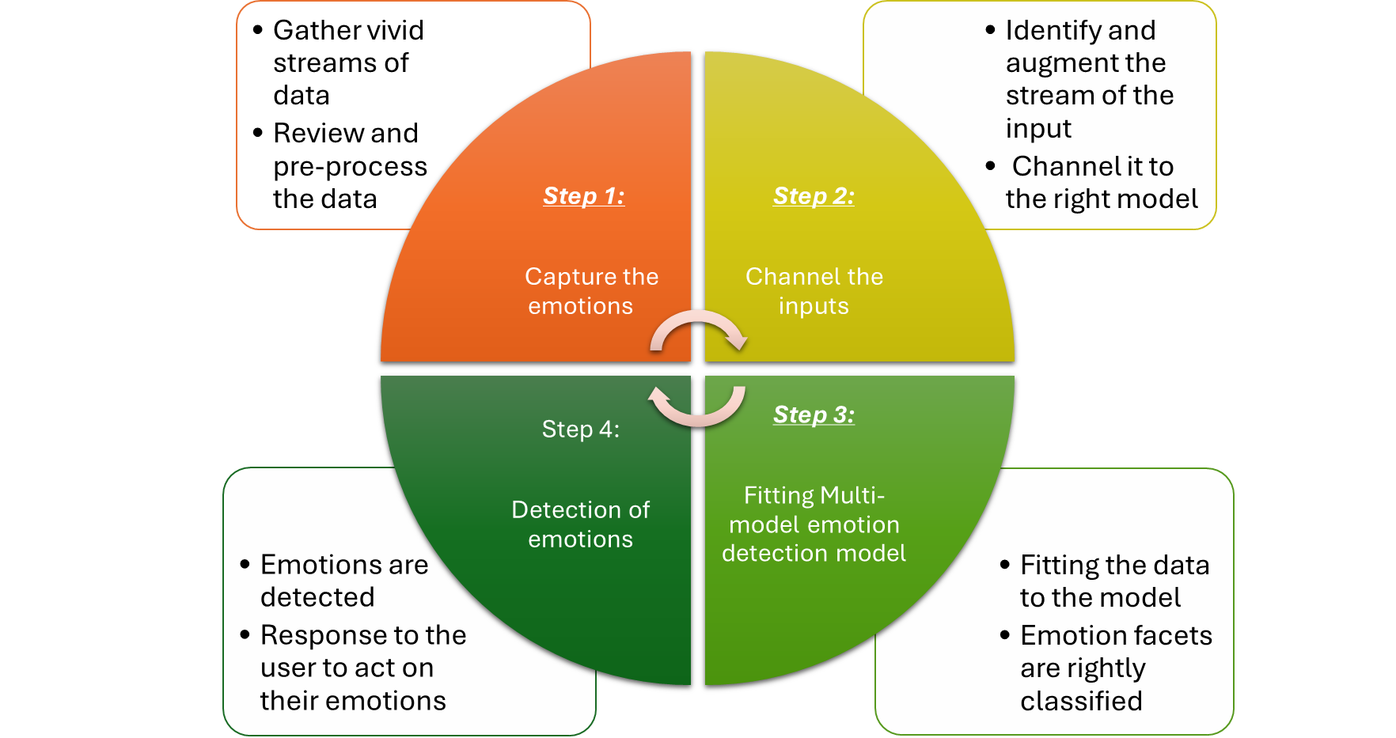
EmotiSense Product Flow

Slide 7
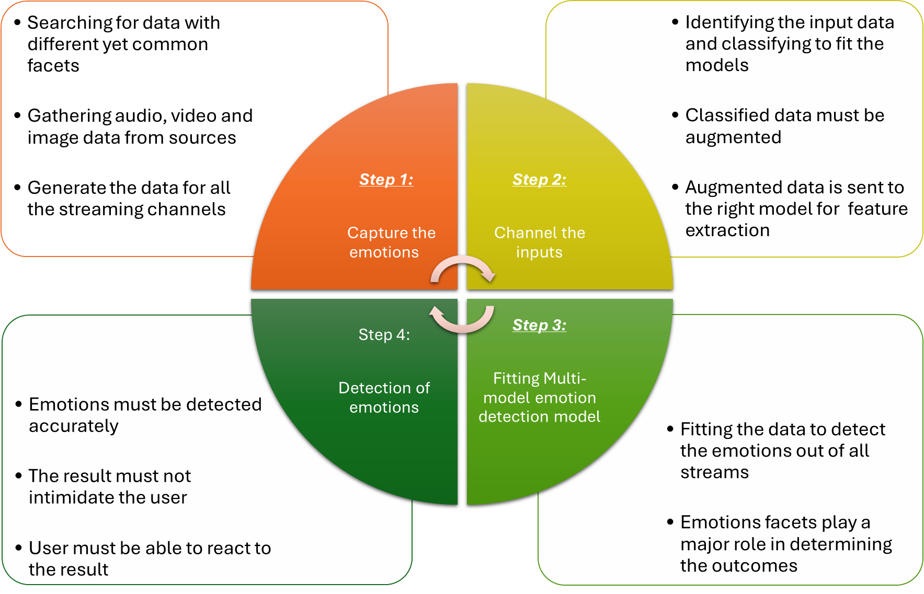
EmotiSense - Challenges

Slide 8
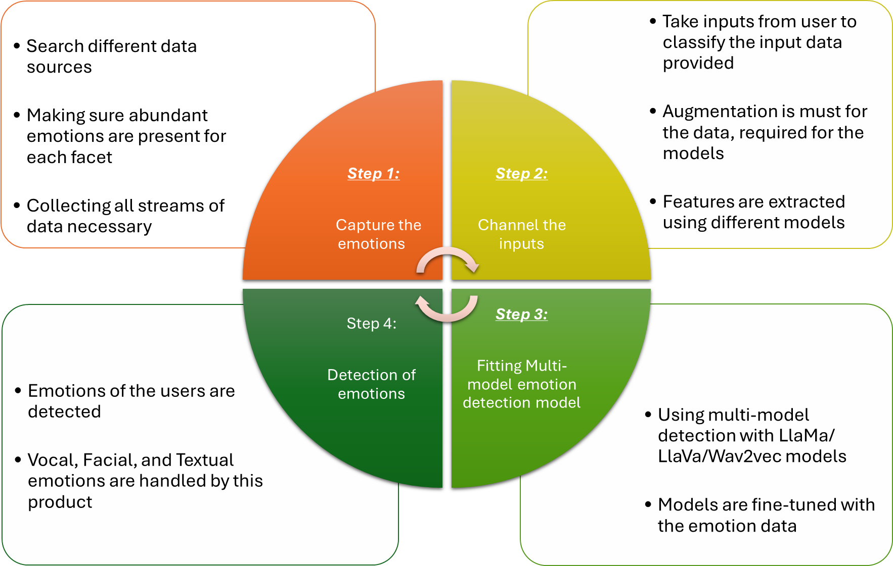
EmotiSense - Solution

Slide 9
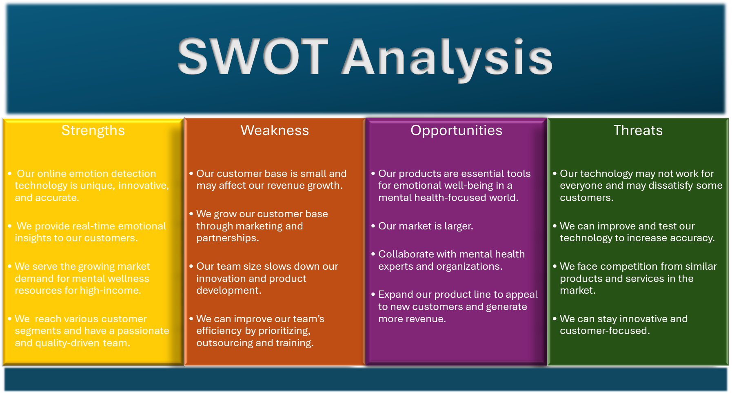

Slide 10
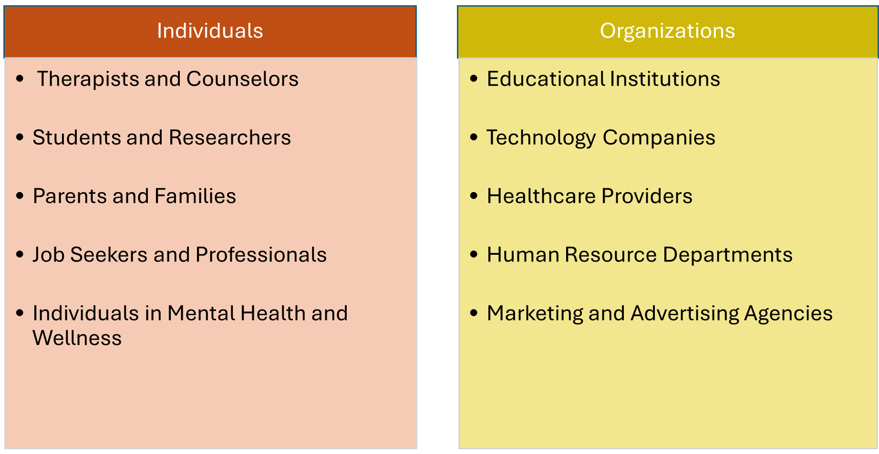
Potential Customer Base

Slide 11
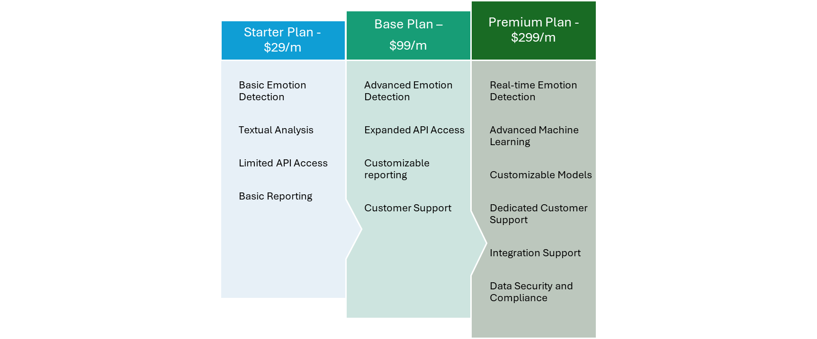
Plans of our Product

Slide 12
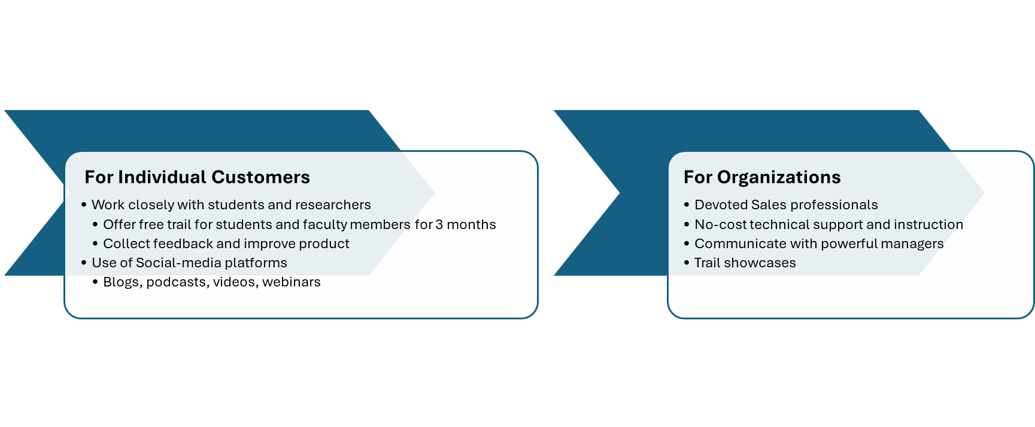
Marketing Strategies

Slide 13
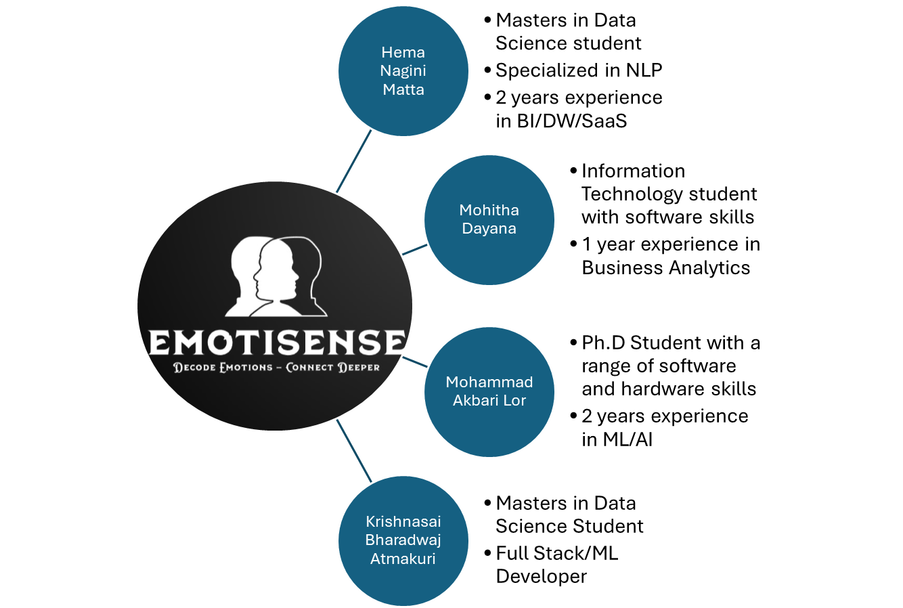
Why
US?

Slide 14
Development Resources | Software Engineers | $20,000- $50,000
 | Data Scientists | $15,000- $40,000
 | UX/UI Designers | $10,000- $30,000
Infrastructure | Cloud Services | $5,000- $15,000
 | Database Management | $3,000- $8,000
 | Hosting | $2,000- $5,000
Licensing and Tools | Large Language Models | $2,000- $10,000
 | Machine Learning Libraries | $1,000- $5,000
Marketing and Promotion | Website Development | $3,000- $10,000
 | Advertising Campaigns | $5,000- $20,000
 | Content Creation | $2,000- $8,000
Miscellaneous | Legal and Compliance | $2,000- $5,000
 | Contingency | $5,000- $10,000
Total Estimated Cost |  | $75,000- $206,000
Cost

Slide 15
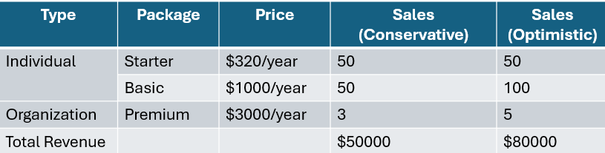
Revenue Projection 2025

Slide 16
Milestones
March 2024
February 2025
August 2024
June 2025
Designing and Creating Framework
Incorporating Live Data Streams
2024 |  |  |  | 2025
Releasing the Initial Product
Adding Video Modality

Slide 17
Thank You!

